Slide 1

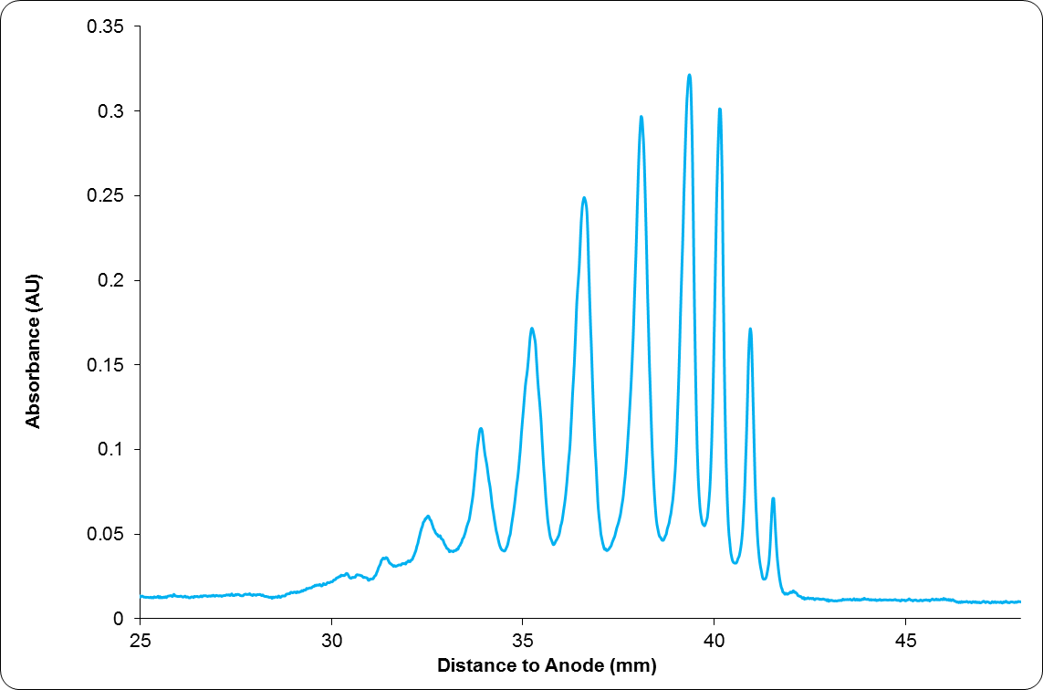
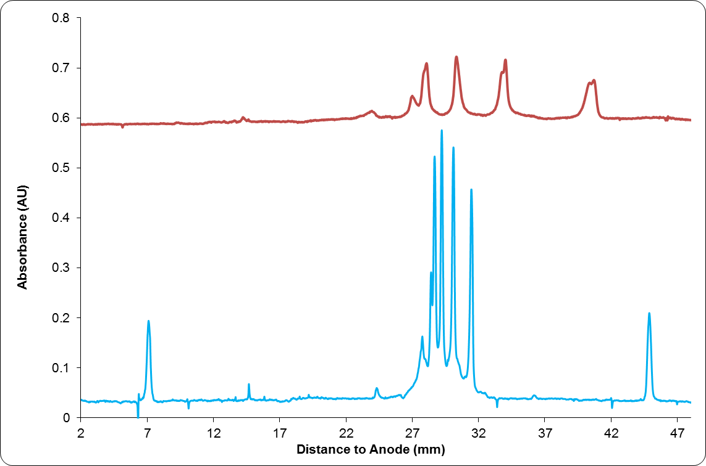
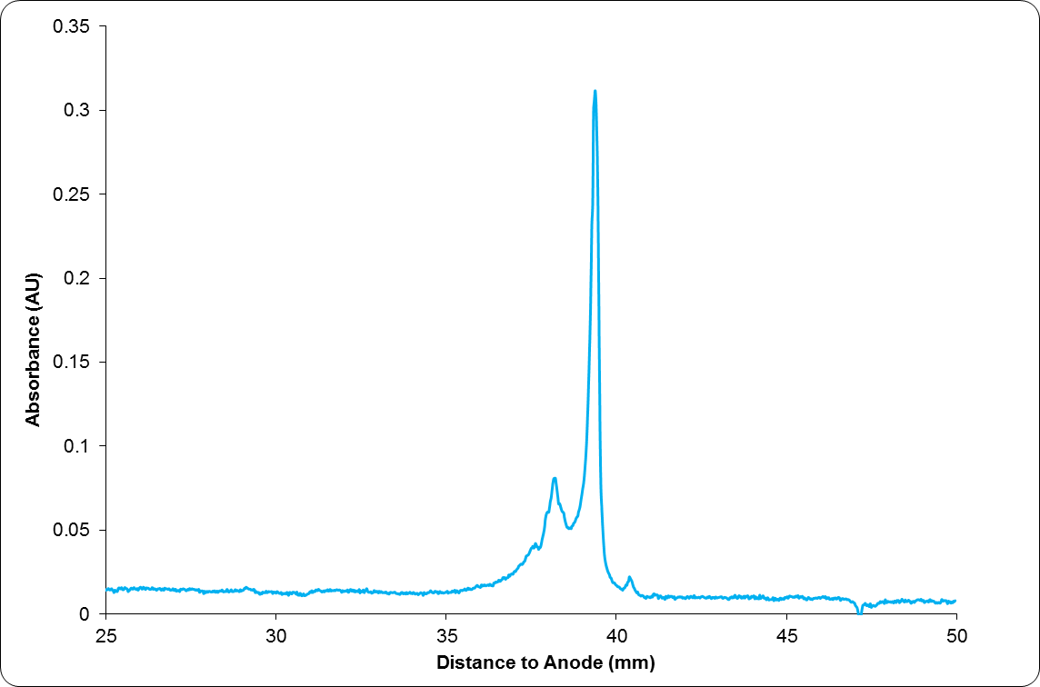
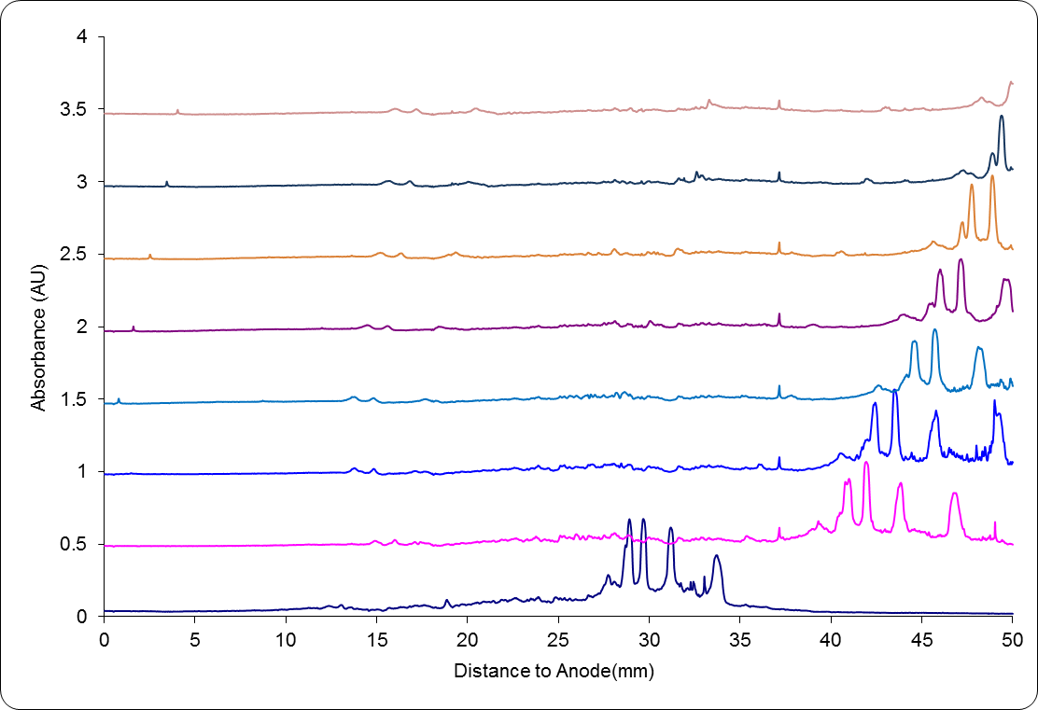
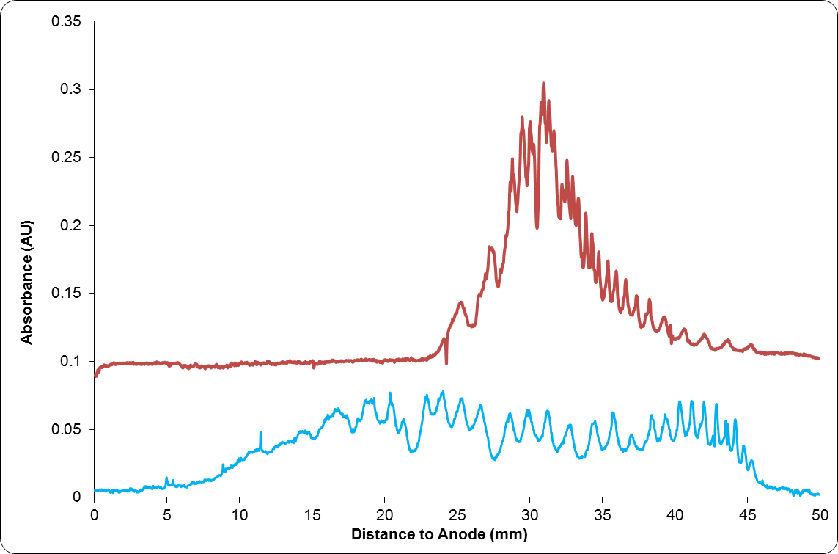
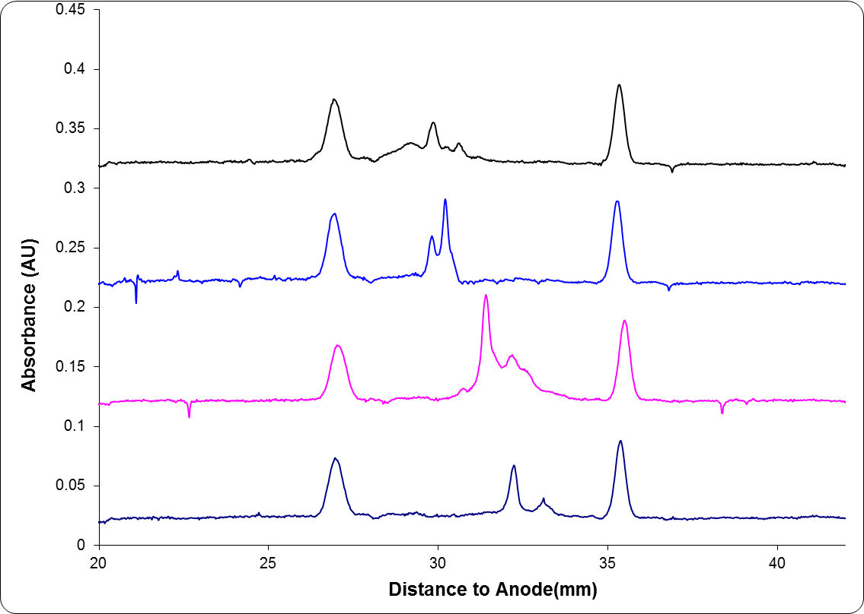
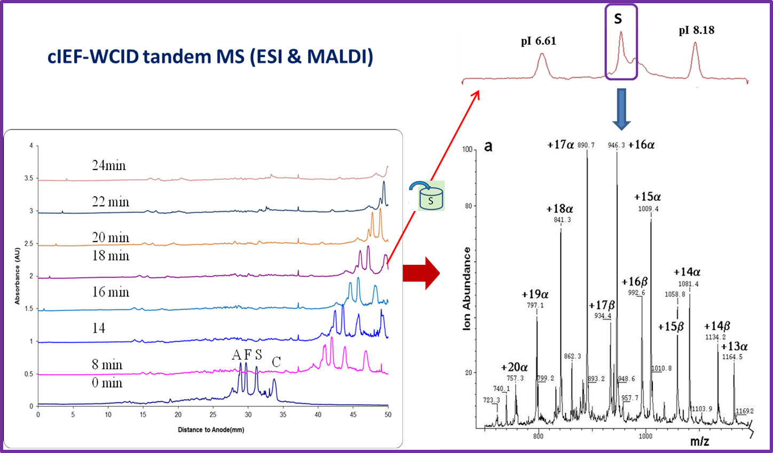
Advanced Electrophoresis Solutions Ltd
www.aeslifesciences.com
Introducing a New Generation of Imaging Detection CE System - CEInfinite
Introduction
High Performance WCID CE
Preparative WCID CIEF
Carrier Ampholytes for CIEF
Whole Column Imaging Detection (WCID) Capillary Electrophoresis (CE) systems have revolutionized protein charge related heterogeneity analysis with Capillary Isoelectric Focusing (CIEF)^{1,2}. Compared to conventional point detection CE systems, WCID provides faster method development, higher detection sensitivity, better reliability, and higher analytical throughput.
Advanced Electrophoresis Solutions Ltd (AES) has made some breakthroughs based on WCID technology:
Highest performance instrumentation
Highest sensitivity cartridges (patent pending)
Preparative CIEF (patent pending)
Specialized carrier ampholytes for CIEF
Key advantages of CEInfinite instrument:
Highly sensitive CMOS imaging sensor
High resolution with HR imaging lens
High scan rate, low noise, stable
Preparative CIEF with CEInfinite proprietary cartridges (patent pending) allows the focused peaks to be transferred into individual collection vials or ion sources of mass spectrometers (MS) for further structure based characterization.
CEInfinite Aeslytes carrier ampholytes (CAs) were specifically developed for CIEF. The main advantages include,
Good pH gradient linearity
Low protein interaction
Low UV absorbance (baseline noise)
Can be used at very low concentrations for MS
HR pH 6-8
A F S C
A F S C
HR pH 3-10
pI 4.14
pI 9.33
Figure 2. CIEF of an antibody drug conjugate (ADC) with CEInfinite 2% HR pH 3-10 and 2% SH8-10.5
Figure 5. Schematic of CEInfinite scanning imaging preparative CIEF
Figure 8. CIEF of hemoglobin AFSC with different pH range CAs.
Total Solution
As a total solution provider, AES has successfully commercialized its unique technologies and released the following CEInfinite product lines:
Instrument system with autosampler option
WCID Cartridges with 100, 180 and 200 µm inner diameter (ID)
Reference Materials
Solutions and Media
Other CE Reagents
All test results in this poster were acquired with CEInfinite instrument systems and related consumables only.
A
F
SH pH 4-8
Figure 3. CIEF of a monoclonal antibody with CEInfinite 1% HR pH 3-10 and 3% HR5-8
S
SH pH 5.5-7
A F S C
C
+HV
CMOS
-
cIEF-MS for protein ID
Figure 9. CIEF of a fusion protein with different pH range CAs.
Membrane or frit
CEInfinite tandem mass spectrometry is a breakthrough for protein identification (the focused peaks to be transferred into individual collection vials or ion sources of MS).
Figure 6. Preparative scanning imaging CIEF hemoglobin AFSC individual peak collection
Conclusions
Sample transfer capillary
Separation capillary
It has been proved that CEInfinite is able to provide unique systematic solutions for analytical and preparative protein CIEF.
Highest detection sensitivity UV absorbance detection CIEF instrument
First on the market preparative WCID CIEF
WCID CIEF online coupling to MS potential
High performance carrier ampholytes for CIEF
-
pI 6.61
A
pI 7.9
F
A
Figure 1. Schematic of CEInfinite imaging detection CE system
S
F
C
S
C
Figure 7. CIEF confirmation of individual peak collection .
References
Sosic Z, et al. Application of Imaging Capillary IEF for Characterization and Quantitative Analysis of Recombinant Protein Charge Heterogeneity. Electrophoresis 29(21) 2008: 4368–4376.
Michels D. et al. Imaged Capillary Isoelectric Focusing for Charge-Variant Analysis of Biopharmaceuticals
BioProcess International 9(10) 2011: 48-54
Figure 4. cIEF-WCID tandem MS: new breakthrough for protein identification

